Slide 1
Best Card
Exposing Credit Risk
Presented by Team 2: Janice Fong Josh Quintana Melvin Torres Pereira Tanupriya Lakshmi Narayana

Slide 2

Tanupriya
Business Problem
Observation
An increasing number of account holders have been failing to meet their minimum payment requirements, leading to a rise in defaults.
Pain Points & Gaps
Higher financial risk & collection costs
Inefficient reactive strategies
Lack of data-driven risk assessment
Notes:
Observation:
An increasing number of account holders have been failing to meet their minimum payment requirements, leading to a rise in defaults. The company currently lacks a proactive mechanism to predict and mitigate these defaults, relying on reactive collection efforts instead.
Pain Points & Gaps:
High financial risk due to unexpected defaults.
Increased collection costs and operational inefficiencies.
Missed opportunities for early intervention strategies.
Lack of data-driven insights to assess customer risk proactively.

Slide 3

Tanupriya
Imagine This…
Total Customers: 26,664 (20,750 Non-Defaulters, 5,914 Defaulters)
Loss from Defaulters:
- Avg. Loss per Defaulter: $43,469.21
5,914 × 43,469.21 = 257,046,261.94
- Total Loss: $257.05M
Reducing defaults by 10% could save ~$25.7M!

Slide 4
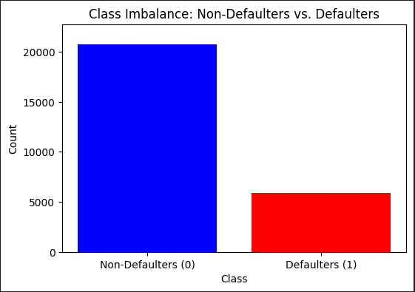
Tanupriya
Understanding the Data
1
Data
26,664 rows and 31 columns
2
Key Variables
Demographic, Credit History Data, Payment delays, Credit balance, Bill statements
3
Target Variable
Default Payment Next Month
4
Class Distribution
Non-defaulter: 20,750 (77.7%), Defaulters: 5,914 (22.3%)
Notes:
Key Features: Demographic and Credit History Data: Includes features such as age, payment history, credit balance, and amount owed.
Potential Predictors of Default: Payment delays, credit balance, and bill statements are likely to be significant predictors.
Features like payment history and bill balance could be strong indicators of default risk.
Class Distribution:
Observation: The dataset is imbalanced, with a significantly higher number of non-defaulters compared to defaulters. This will need to be considered during model training to avoid bias toward the majority class.

Slide 5
Janice
Solution
Feature Engineering
Machine Learning Models
1
2
3
4
Predictive Analytics
Class Distribution Adjustment
Notes:
Mitigation Plan: Implement a predictive model to identify high-risk customers before they default. This will enable future proactive interventions such as targeted reminders, adjusted credit limits, or personalized repayment plans. By having this model, the company can reduce defaults, optimize risk management, and maximize profitability.
📊 Predictive Analytics – Analyzes past financial behavior to assess default risk. allow us to analyse potential customers who will default. We could either reject their credit card application or provide personalized credit card plan
🗃️Key Variables - Credit Utilization, Number of Late Payments in last 6 months
🔨Techniques to mitigate imbalance data: Ensemble Methods, GridSearch, SMOTE, and Optuna
🤖 Machine Learning Model – Uses classification algorithms (Logistic Regression, Random Forest, XGBoost) for accurate predictions.
Suggested Grouped Visuals:
Model Workflow
Model Workflow Diagram: Shows the data flow from input to prediction, giving a high-level view of the steps your model takes to make predictions.
Model Evaluation and Performance
ROC/AUC: Displays how well the model distinguishes between the classes (default vs. non-default).
cross_val_score: Shows cross-validation results to evaluate the model's robustness.
classification_report: Provides detailed performance metrics like precision, recall, and F1-score.
Feature Importance
Logistic Regression: Coefficients and Odds Ratios: Shows the influence of each feature on the model's prediction, helping to interpret the impact of individual features.
RandomForest: Feature Importance: Displays the importance of each feature in the model, helping you understand which variables are most influential in predicting defaults.

Slide 6
Janice
Feature Engineering
Data Cleaning
Check missing values
Feature Creation
Created new features: Late Payments, Credit Utilization
Feature Selection
Dropped features,
Feature Transformation
Scaled data, Encoded target variable
Data Splitting
75% Training, 25% Testing
Notes:
Data Cleaning: Check missing values
Feature Engineering: Created new features
Late Payments = Number of Late Payments in last 6 months
Credit Utilization = Latest Bill Statement Amount / Limit Balance
Data Preprocessing:
Dropped features: duplicate columns, Bill statements
Scaled the data: StandardScaler
Encoded the target variable: LabelEncoder
Data Splitting: 75% Training, 25% Testing

Slide 7

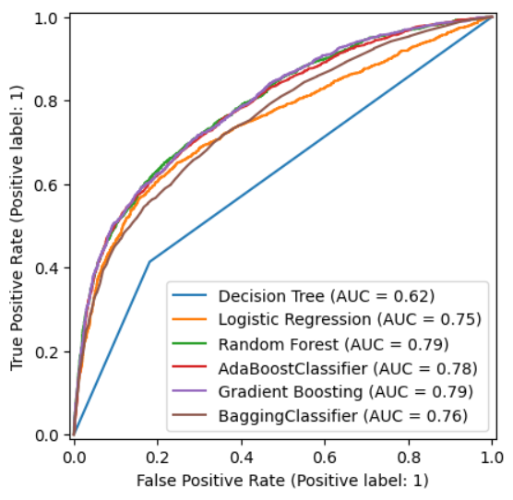
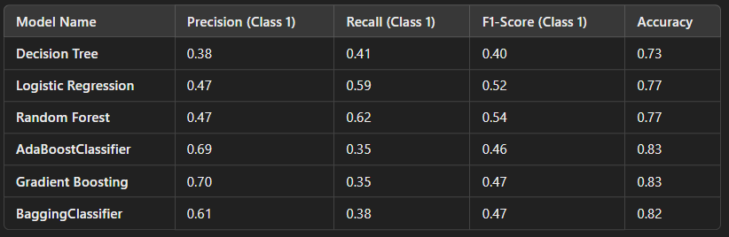
Josh
How Well Did Our Model Perform?
Notes:
"On the left, we have the ROC curve, which shows the trade-off between the True Positive Rate and the False Positive Rate."
"The closer the curve is to the top-left corner, the better the model is at distinguishing between classes."
"Among our models, the Random Forest and Gradient Boosting models have the highest AUC values at 0.79, followed closely by AdaBoost at 0.78."
"On the right, we have a table summarizing the Precision, Recall, F1-Score, and Accuracy for each model."
"Higher recall means the model captures more actual positives, while precision tells us how many of the predicted positives were actually correct."
"F1-score balances these two, and accuracy provides an overall correctness measure."

Slide 8

Josh
Next Steps
Deploy Model
1
Integrate the model into BestCard's credit risk system.
2
Pilot Program
Validate performance with real customer data.
Refine Strategies
3
Develop customized repayment plans for high-risk customers.
4
Continuous Monitoring
Update the model regularly with fresh customer data.
Notes:
1. Deploy the predictive model into BestCard’s credit risk system.
2. Start a pilot program with real customer data to validate performance.
3. Refine intervention strategies for high-risk customers.
4. Monitor and adjust the model to improve long-term accuracy.
5. Scale the model across all customer segments for maximum impact.

Slide 9
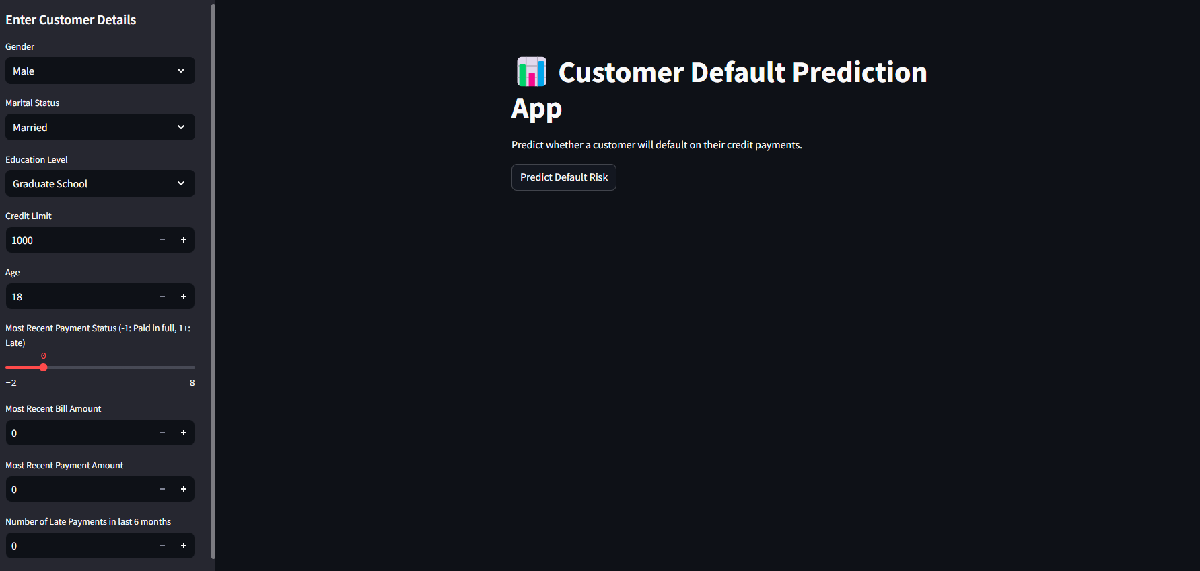
Josh
Demo Time

Slide 10






Melvin
What Should BestCard Do?
Early Risk Detection
Flag high-risk customers before they default.
Targeted Interventions
Offer customized repayment plans to at-risk customers.
Smart Credit Limit Adjustments
Reduce limits for high-risk customers
Proactive Customer Support
Educate customers about responsible credit usage.
Continuous Monitoring
Update the model regularly with new data
Notes:
1. Early Risk Detection: Use our model to flag high-risk customers before they default.
2. Targeted Interventions: Offer customized repayment plans to at-risk customers.
3. Smart Credit Limit Adjustments: Reduce limits for high-risk customers to prevent over-borrowing.
4. Proactive Customer Support: Educate customers about responsible credit usage.
5. Continuous Monitoring: Update the model regularly with fresh customer data.

Slide 11

Melvin
Business Benefits:
Why This Matters
Reduces financial losses
Improves cash flow
Replace image with happy faces
Make some joke
Enhances customer relationships
Strengthens regulatory compliance
Supports long-term profitability
Notes:
• Reduces financial losses by preventing high-risk lending.
• Improves cash flow through better repayment forecasting.
• Enhances customer relationships by offering personalized financial solutions.
• Strengthens regulatory compliance with better credit risk management.
• Supports long-term profitability by lowering default rates.

Slide 12

Melvin
Happy Banker

